Slide 1
Expansion of Islam

Slide 2
Arab Forces
Neither militia nor was it professional
Fought for share of booty
Individual armies 20,000-30,000
Primarily light infantry, carrying spear for defense and sword for offense
Few archers/cavalry
Often dismounted in battle
Often used fortification
Quick marching

Slide 3
Rise of Caliphate
Muhammad died in 632
Abu Bakr appointed Caliph
Arab tribes revolted against him in the Ridda wars
United after a year of fighting
Abu Bakr decided to expand

Slide 4
Why expand
Along the borders between Arabia and these two great empires were numerous Arab tribes leading a nomadic life and forming a buffer-like state between the Persians and Romans. Abu Bakr hoped that these tribes might accept Islam and help their brethren in spreading it.
The Persian and Roman populations suffered with very high taxation laws; Abu Bakr believed that they might be persuaded to help the Muslims, who agreed to release them from the excessive tributes.
Two gigantic empires surrounded Arabia, and it was unsafe to remain passive with these two powers on its borders. Abu Bakr hoped that by attacking Iraq and Syria he might remove the danger from the borders of the Islamic State.

Slide 5
Conquest of Iraq
Began as a series of lucrative raid
Volunteer army of 18,000 led by Khalid ibn al-Walid.
Used countermarches to tire out immobile Persian troops at the Battle of Chains
Named so because the Persians chained themselves together
At the Battle of the River, Khalid won after successfully killing all Persian generals in champion fights

Slide 6
Battle of Walaja
Khalid outnumbers 30,000 to 15,000
Sent his cavalry to the rear of Persian position
Khalid attacked

Slide 7
Khalid retreated to draw Persians in

Slide 8
Khalids calvary attacks the rear

Slide 9
Persians massacred

Slide 10
Battle of Ullais
Straight forward battle
Persians retreated after fierce fighting
Khalid captured the retreating army and all were executed. Beheading took three days

Slide 11
Conquest of Levant
Abu Baker also invaded the Levant
Controlled by Byzantium
Contested with the Persians
Four pronged invasion
Stopped by large Roman force

Slide 12
Freed up by daring attack on Byzantine flank thru the desert by Khalid

Slide 13
Siege of Damascus
Byzantine forces tried to stop approaching armies
Muslim forces are able to approach and lay siege
Conquered the city but Abu Baker dies in the process
Byzantine prepare a counter-attack

Slide 14
Battle of Yarmouk
Khalid consolidated the Arab armies in face of this large counterattack
Force size varies:
Arabs Byzantine
20,000-40,000 50,000-400,000
Battle would last six days
Persians and Byzantines had agreed to both attack Arab forces

Slide 15
Day 1
Limited attacks by Byzantines to test the veteran Muslims

Slide 16
Day 2
Phase 1
Byzantine attacked on all fronts
Goal was to push the wings back
Khalid delayed this with cavalry
Eventually the wings retreated

Slide 17
Day 2
Phase 2:
Khalid counterattacked on their right
Left flank damaged badly
Retreated towards camp
Shamed by Muslim women

Slide 18
Day 2
Phase 3:
Khalid’s mobile forces then stabilized the left
Both sides settled

Slide 19
Day 3
Phase 1:
Byzantines attacked the Muslim right flank
As it withdrew, Muslim women shamed them

Slide 20
Day 3
Phase 2:
Khalid counterattacked this exposed part of the Byzantine army
Bloody fighting followed and both sides retired

Slide 21
Day 4
Phase 1:
The battle repeated from day three
Khalid had his left flank attack to prevent broad Byzantine advance

Slide 22
Day 4
Phase 2:
Khalid divided his mobile troops and attacked Byzantines on multiple fronts
The Byzantines made serious progress elsewhere
Muslims retreat, losing entire rearguard while reorganizing

Slide 23
Day 5
Nap day!

Slide 24
Phase 1 and 2:
General Muslim attack
Massed Muslim Calvary attached the Byzantine left, pushing it back
Muslims continued down the line

Slide 25
Phase 3:
Byzantines attempted to regroup their Cavalry
It was too slow and Khalid scattered them

Slide 26
Phase 4:
Cavalry then attacked the Muslim left center
Broke under pressure

Slide 27
The last phase:
General Byzantine retreat started
Many died while fleeing as most routes covered
50,000-120,000 Byzantines killed
3,000 Muslims

Slide 28
Levant Lost of Muslims

Slide 29
Conquest of Persia
Persia and Byzantines had made an alliance
Persians failed coordinate their attack
Partly due to “peace efforts” by Caliph Umar
Muslim forces defeated each in turn

Slide 30
Battle of Qadisiyya
Caliph Umar decided to turn on Persia
Starting gathering armies throughout his Caliphate
Persian troops were green recruits due to previous losses
Persians Muslims
60,000 (33 elephants) 30,000-40,000

Slide 31
Deployment

Slide 32
Day 1
Phase 1:
Bloody champion duels
Persians left wing advance with arrow showers and elephants
Muslims fall back

Slide 33
Day 1
Phase 2:
Muslim cavalry counter attacked and Persians retreat

Slide 34
Day 1
Phase 3:
Persians attack Muslim left
Volleyed with arrows and charge led by elephants
Muslims fall back

Slide 35
Day 1
Phase 4:
Muslims route elephants in counter attack
Two prong counter attack

Slide 36
Day 1
Phase 5:
Muslims general attack on the Persian front
Fighting ended at dusk with heavy losses on both sides

Slide 37
Day 2
Starts with champion fights
Syrian reinforcement arrived for Muslims
Muslim ordered general attack to exploit missing elephants
No progress

Slide 38
Day Three
Phase 1:
Started with volleys of arrows
Elephants back, led the charge
Muslims began to fall back

Slide 39
Day Three
Phase 2:
Muslims mutilate the elephants, causing havoc in Persian lines
Muslims issued a general attack to no avail
Bloodiest day of fighting, went thru the night

Slide 40
Day Four
Phase 1:
Muslims attacked the Persian right
Special forces penetrated lines to kill the Persian general during a sandstorm

Slide 41
Mystery Death of Rostam
Rostam found with 600 wounds
Crushed by a camel load of weapons and beheaded
Found dead

Slide 42
Day Four
Phase 2:
Persians unaware of their commanders death
Successfully push back Muslim advance
Upon learning of his death, demoralized

Slide 43
Retreat
22,000 Persians killed
8,500 Muslims killed

Slide 44
Finishing the Sassanids
Siege of Ctesiphon
Battle of Nahāvand

Slide 45
Muslim Conquest of Egypt

Slide 46
Crossing into Egypt
Sent only 4,000 men
Tried to bring them back but the commander “refused”

Slide 47
Initial Sieges
Muslim forces laid siege to multiple fortified cities
The Most important being Babylon
Babylon remained unreached and the reinforced Muslims marched on Heliopolis

Slide 48
Battle of Heliopolis
20,000 Romans Vs. 15,000 Arabs
Muslims split there army into three
One part ambushed the Byzantine rear while the other waited for fleeing solders
Entire Byzantine force destroyed
Coptic Christians betrayed Romans afterwards for lower taxes

Slide 49
March to Alexandria
Next target for Muslims
Byzantines successfully launched stalling forces along the way

Slide 50
Siege of Alexandria
The Byzantines made their last stand
The siege lasted 7 months
This marked the end of Byzantine control
This was a huge blow Rome's food and taxes primarily came form Egypt

Slide 51
Egypt

Slide 52
First Invasion of North Africa
Turned back for tribute
Series of Civil Wars and assassinations halted expansion until rise of Umayyads

Slide 53
Umayyads expansion
Conquered Part of Anatolia
Conquered part of Modern Day Afghanistan

Slide 54
Second Invasion of North Africa
Successful conquest the took most of North Africa
Arab forces however ambushed and destroyed by Berber/Byzantine
A relieving force avenged the Arabs but was then pushed back by Byzantine forces

Slide 55
Third Invasion of North Africa
Successful conquest of North Africa and expulsion of Byzantine Forces
Berbers (think Hannibal's cavalry) converted on mass

Slide 56
Expansion Slowed 733

Slide 57
First, Some Recap

Slide 58
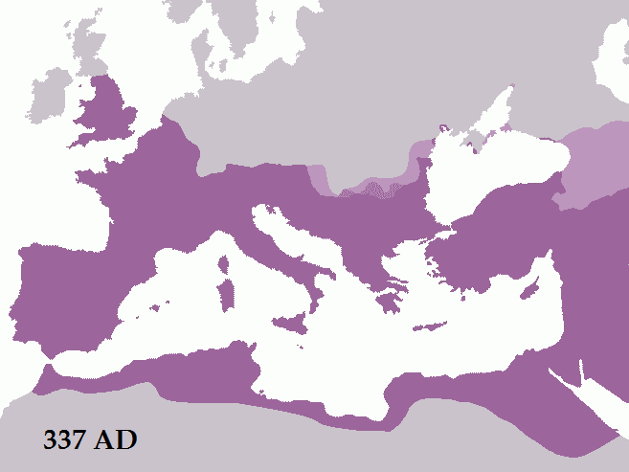
Roman Empire
At the Death of Constantine
Map Credit: Tataryn77

Slide 59
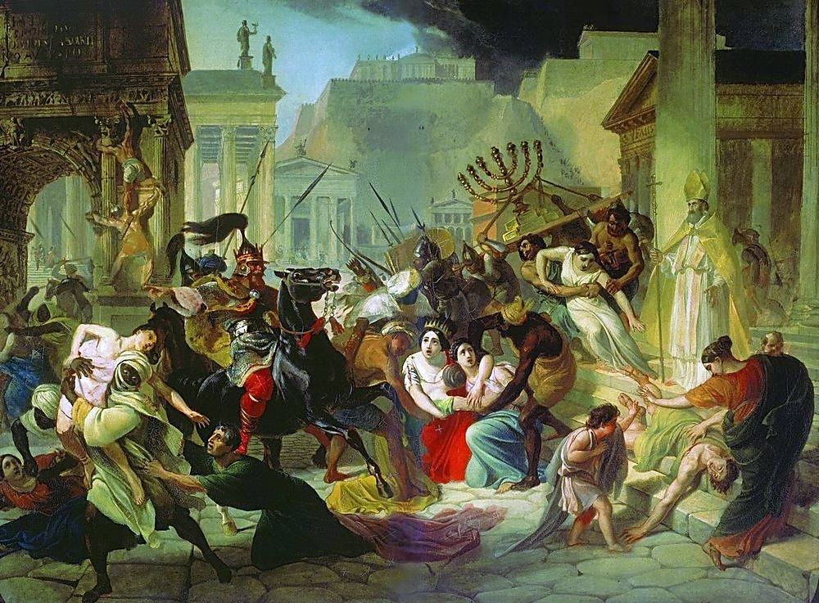
Barbarian Invasions
5th century
A Russian artist’s rendering of the Sack of Rome in 455 by the Vandals

Slide 60
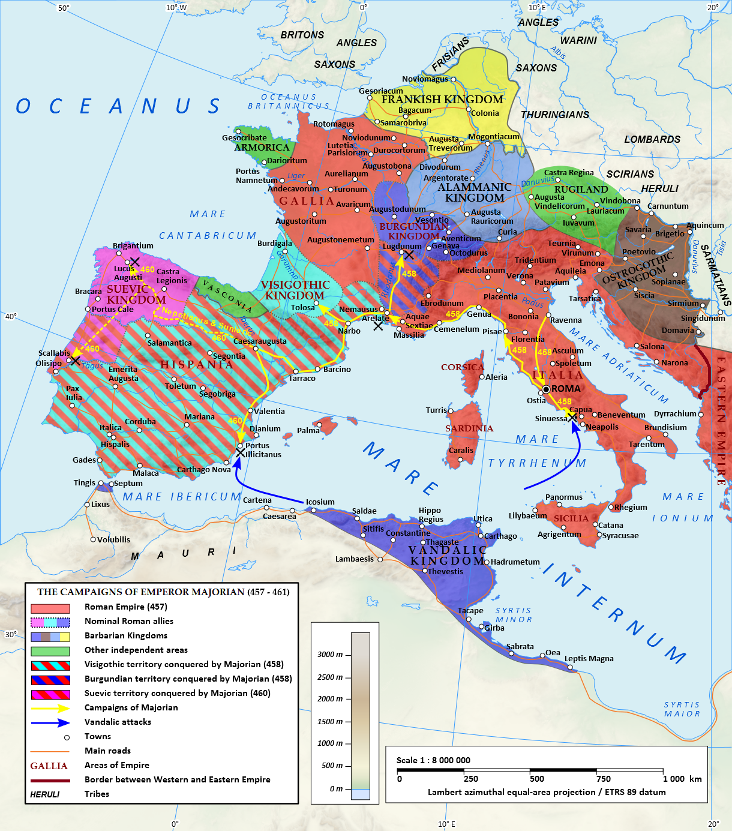
ROME on the Ropes
Map Credit: Tataryn

Slide 61
FRANKS
OSTROGOTHS
VISIGOTHS
VANDALS
Map Credit: Tataryn

Slide 62
Who where the Visigoths?
Germanic Peoples
Came to Rome looking for shelter
Rebelled under Alaric (the movie we watched)
Established a new Kingdom in Spain

Slide 63
Precursor to Invasion
Spain mainly Romans
Civil War for the throne
Long standing relations with North Africa
Raiding and Trading

Slide 64
Why did Islamic forces invade?
sent to aid one side in a civil war
force sent to test the military strength of the Visigoths
first wave of an invasion
large raiding expedition

Slide 65
Islamic Victory
Mainly Berber forces win
Visigoth Rule collapsed
Islamic Forces fill the power vacuum
People of Hispania happy with change

Slide 66
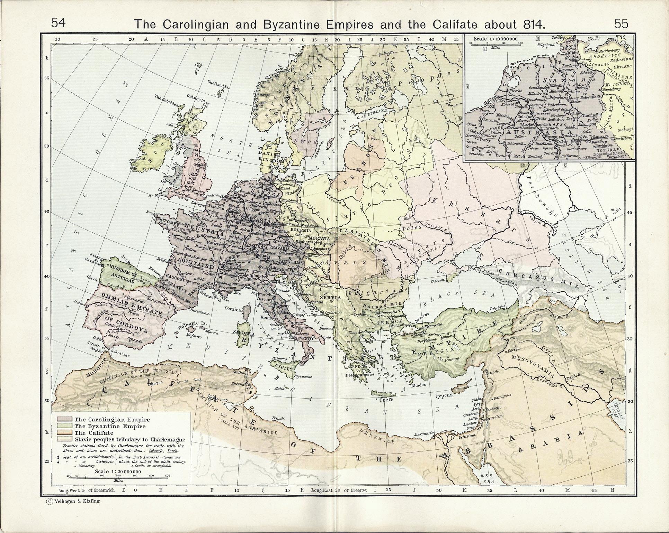
Medieval Empires
Franks
Byzantines (E. Roman Empire)
Islamic Caliphate

Slide 67
Medieval Empires
Franks
Byzantines (E. Roman Empire)
Islamic Caliphate

Slide 68
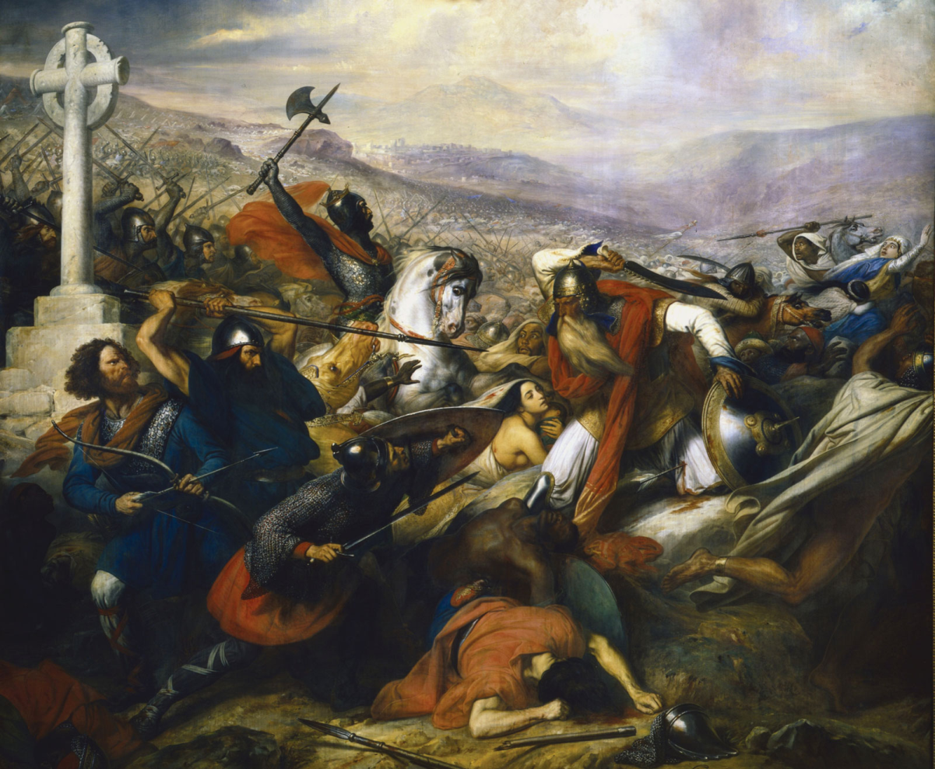
Charles “The Hammer” Martel
Battle of Tours (732)

Slide 69
Civil Wars between 650-750
657-661 Shi’a Sunni Split, Umayyad Caliphate
680-684 Syria Primacy, Professional Army, New Conquest, Battle of Ra’s al-Ryn 685 pg 146
Religious and Military problems cause third civil war

Slide 70
Umayyads
Control of Egypt and Iraq made sole superpower
80% revenues went to army
Power based on professional army

Slide 71
Problems
Allegiance to generals
Generals had access to fiscal resources
Power struggle between armies based on tribal and power differences

Slide 72
Abbasid Revolution
From Northern Persia
Won Third Civil War
Moved Caliph to Bagdad
Syrian Army replaced
Army still played politics

Slide 73
Problems with Islamic Law
Cannot have fellow Muslims in servile status
Limited conscription and hurt the government

