Slide 1
Name ___________________________________________________ Date _____________ Hour _______________
Human Migration Mapping Activity
Today, we will be going to the fishbowl to examine human migration throughout the world using the following internet resource Bradshawfoundation.com . You will be color-coding a map and matching it to a summary chart. I completed the first two boxes to provide an example.
Arrows should be colored to
Coordinate with timeline
and info boxes
These should be color coded to match
the arrows you’ve drawn on the map
A place for the title of that
Section
A summary for that era of human
migration

Slide 2
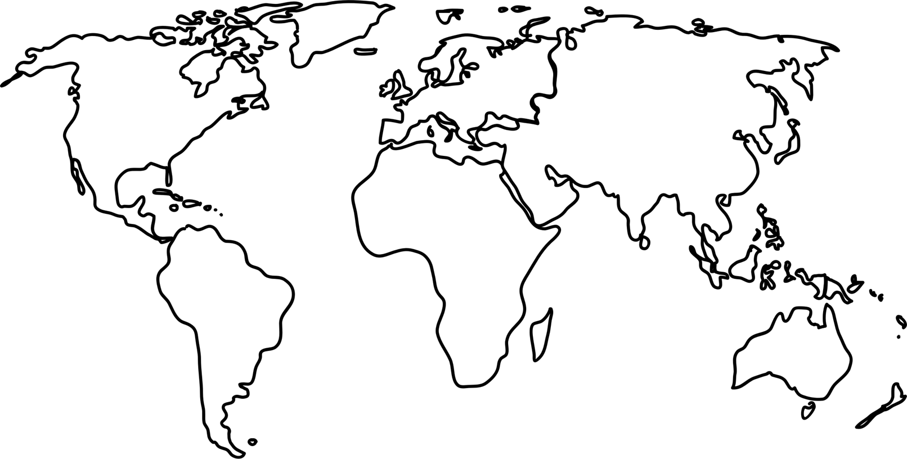

Slide 3
Africa Origins
Over 160,000 years ago Homo sapiens lived in African, our DNA evidence places them in East Africa
160,000 – 135,000
They spread to South Africa, the Congo, and Ivory Coast

