Slide 1
Egypt

Slide 2
Old Kingdom 2686–2181 BCE
Majority of conflicts fought against raiding parties
Volunteer Armies
Bow and Arrow the favored weapon

Slide 3
Middle Kingdom 2055–1650 BCE
Began to expand territory
  For protection
  To expand trade

Slide 4
Second Intermediate Period 1650–1550 BC
Canaanite tribe called the Hyksos sacked the Egyptians' capital
Claimed Upper and Lower Egypt.
Many fled to Thebes and began to oppose the Hyksos rule.

Slide 5
Impact of Egypt
The Hyskos brought horses, chariots, and composite bows.
Egyptian Resistance spawned a professional army (two grand divisions)
Hyskos eventually overthrown, starting the New Kingdom

Slide 6
Thutmose III and Empire
New Kingdom Pharaohs expanded Egypt's territories but did not however reorganize them
The King of Kadesh led a revolt of Syrian territories
Thutmose III led his army and destoryed resistance in the Battle of Megiddo

Slide 7
Religious Collapse
Amenhotep IV abolished Egyptian religion and established a monotheistic religion
He was succeeded by King Tut, who was forced to restore the old ways
He died at a young age
During the disturbance Syria was lost to the Hebrews and Hittites (1000 years after Thutmose III)

Slide 8
Ramsese II from Chaos
Ramses I established a new Dynasty after the religious chaos
His grandson was Ramses the Great (II)
He set out to regain Kadesh from the Hittites but there were two major problems:
  The Army was replaced with mercenaries
  The Hittites had Iron weapons

Slide 9
Hittite Warfare
The Hittite Chariot:
Two wheeled but heavier than the Egyptian
It carried a crew of three:
  A driver
  Shield bearer
  And an archer
Hittite battle tactics were focused on the offensive use of the chariot with infantry in support.

Slide 10
Battle of Kadesh
Egyptians Under Ramses II
Hittites Under Muwatalli II
20,000 men
16,000 infantry
2,000 chariots
  4,000 men
40,000 men
31,000 infantry
3,700 chariot
  9,000 men

Slide 11
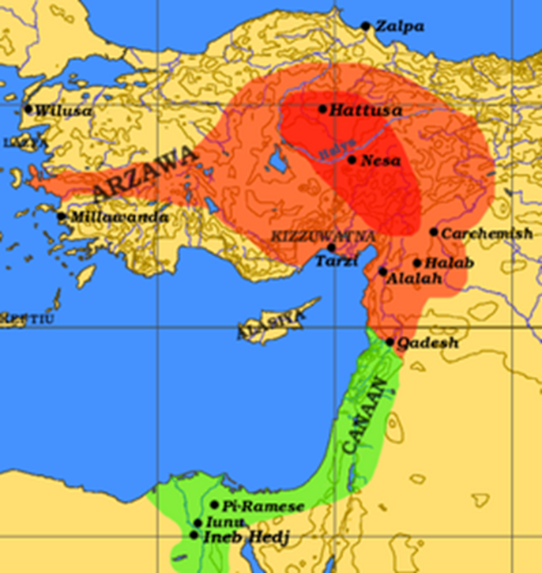
Battle of Kadesh
Spring of 1274 BCE Ramses approached Kadesh
Was misled by two spies and Fell into a trap

Slide 12
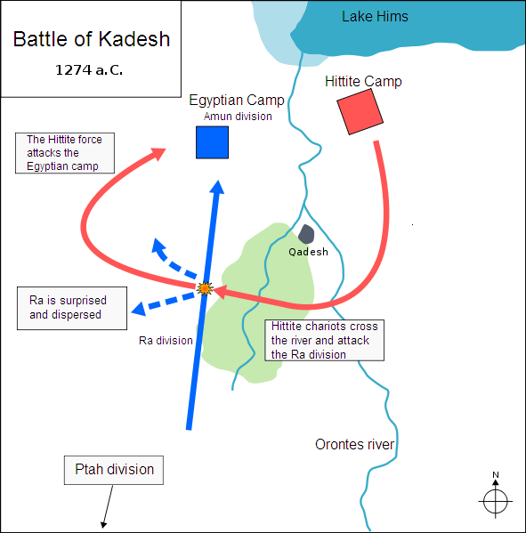
Battle of Kadesh
In haste Ramesses II increased the distance between his Divisions , an errie
failed to dispatch scouts
sent urgent messengers to the rest of his army,
Hittites chariots attacked the Ra division and almost destroyed.
Survivors fled the camp, but they were pursued by the Hittite forces

Slide 13
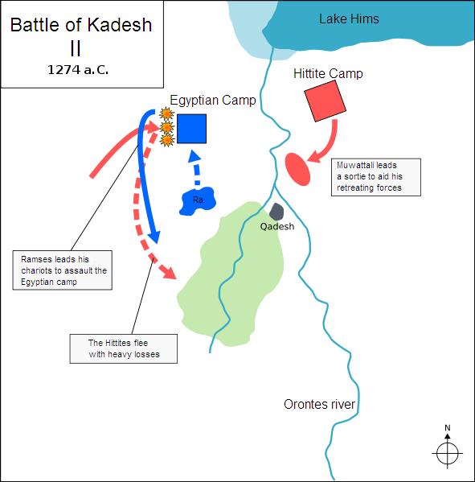
Battle of Kadesh
Hittite chariots and began their assault.
There was Panic among the Egyptian troops
However momentum of the Hittite attack slowed due to obstacles of such a large camp.

Slide 14
Battle of Kadesh
The Hittites believed their enemies routed
stopped to loot the Egyptian camp
easy targets for Ramesses' counterattack.
In the ensuing pursuit, the heavier Hittite chariots were easily overtaken by faster, Egyptian chariots
Surviving chariots used their the superior speed and composite bows to punish overextended and tired Hittite chariot

Slide 15
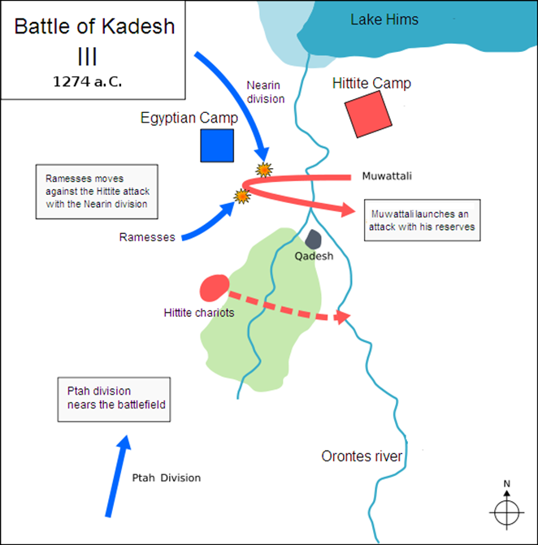
Battle of Kadesh
Muwatalli still commanded a large force of reserve chariots and infantry
As the retreat reached the river, he ordered another thousand chariots to attack the Egyptians,
As they approached, they were intercepted by the rest of the army
Ramesses had also attacked from the camp.

Slide 16
Results
Rameses left after the battle
A Pyrrhic Victory
Last victory of the empire
Also invaded by mysterious “Sea People”

Slide 17
https://www.youtube.com/watch?v=d8f1FUwTv8Q

