Slide 1
Macedon: Birth of Combined Arms

Slide 2
Background
Considered Greek backwater
“Barbarians”
Nobility undermined the Kings
During the Peloponnesian, Wars only had 400 Cavalry a bad infantry
Afterwards, Macedonia is badly defeated, Phillip II becomes king

Slide 3
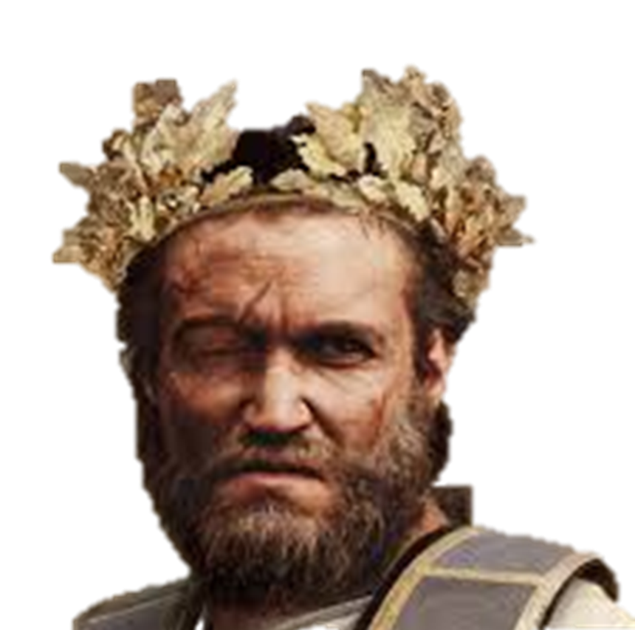
Philip II
Phillip II grew up as a hostage in Thebes
He was able to study the reformed in Athens and learn from Epaminondas
Added to the reforms
Perfected the phalanx
Integrated it into a flexible combined arms tactical system

Slide 4
Reforms
Standardized weapons and discipline to the phalanx
Constant Practice, experience, and action
Created citizen soldiers whose status came from service to the king
Communal Cohesion
Drill and Discipline
Soldiers paid, allowing maintenance of farms
Best parts of Citizen and Professional troops
This balanced power with Nobility

Slide 5
Macedonian Phalanx

Slide 6
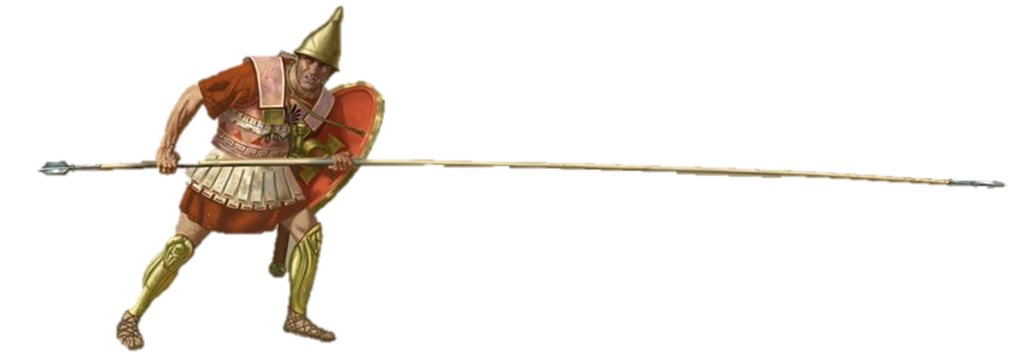
Sarissa
14-18 foot pike
Required two hands to use
Made of resilient cornel wood, iron head, and bronze butt-spike
Spike as counter-balance
Possible that Sarissas could be broken down
When used in coordination deadly, useless in single combat

Slide 7
Phalangite Equipment
A
C
Phyrangrian Helm – Typically Bronze or Iron
Linothorax - cuirass of stiff linen built up of glued or stitched layers of textile; possibly leather
Telamon shield – similar to Pelta, strapped to the shoulder since hands were needed for Sarissa
Kopis – One of several sowrd types used as secondary weapons
Knemides – Bronze, similar to hoplites
B
D
E

Slide 8
Macedonian Phalanx
Fought typically 16 men deep, 16 across
Professionally drilled
Sarissa required special training
First 5 rows had spears down
Later rows had at 45 degrees to deflect missiles
Light Armor to increase speed
Flanks Vulnerable

Slide 9
Companion Cavalry
Macedonia traditionally a cavalry power
Companions made up as nobles
Many died prior to Phillip
He made many supporters new nobles
Increased numbers/loyalty
Carried a 12 ft spear called the Xyston
Double ended, if broken still had a weapon
Heavily armored, like hoplites

Slide 10
Hypastists – Shield Bearers
Means shield-bearer
Essentially were Greek hoplites
Numbered around 3000
Protected the flanks of the phalanx and act to link them to cavalry
There training and tactical flexibility made them critical

Slide 11
Other Units
Thessalian Heavy Allied Cavalry
Considered best cavalry in Greece
Protected Left Flank, mostly defensive
Used the Rhombus formation
Used a variety or regional/ specialized troops, including hoplites
These troops provided tactical diversity

Slide 12
Operations
Emphasized Mobility
Carried their own supplies
Limited pack animals
Could campaign year round
Used mobile siege train
Including engineers and war engines

Slide 13
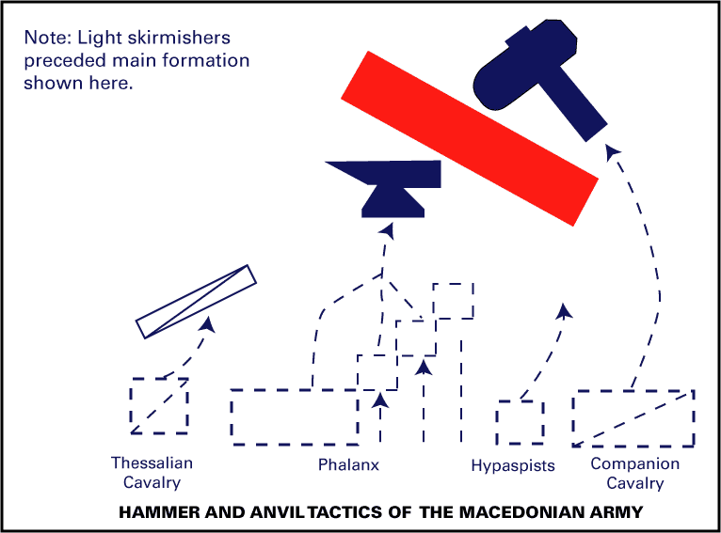
Major Tactics
Flying Wedge
Cavalry Formation
20 men deep and 20 men wide as base – 200 total
Leader at point to direct the wedge
Allowed exploitation of gaps in enemy lines
Needed a gap to be effective
Hammer and Anvil
While the infantry lines are fixed, a cavalry force attacks from behind

Slide 14
Goals
Phillips goal was to expand Macedonia
The Balkans were his target but Greek fear brought them into conflict
Philip II marched against Thebes and Athens at Chaeronea

Slide 15
Battle of Chaeronea
https://www.youtube.com/watch?v=-0YsoaN__8U

Slide 16
Uniting Greece
Created the Hellenic League
Consisted of Greek states
Macedon not a member but had alliances with each state
Benefits from league without being bound
Unified foreign policy and military leader, or hegemon
Title given to Philip and his successors
Ratified and declared war on Persia

Slide 17
Before he could invade Persia, Phillip murdered
Alexander III becomes king

