Slide 1
Conflict in the Greek World
War and Historical Bias

Slide 2
Persian War
Ethnics Greeks in former Lydia revolt
Ionian Revolt
Athenians are ethnically Ionian, send help
Revolt Crushed

Slide 3
Darius Mad
Has a servant tell him every meal “Lord, remember the Athenians”

Slide 4
First Greco-Persian War
Persia invades
Athens send a runner to Sparta
About 200 miles round trip – two day run
Spartans busy
Athens face Persia 26.3 miles away at Marathon
Athens win despite outnumbered

Slide 5
Myth of Marathon
Man runs to Athens, yells Nike, and dies
Real feat was Army quick marched back in full gear
Beat Persian fleet

Slide 6
Greeks Unite
Darius died
Son Xerxes takes up family business of hating Greek
Greeks join forces
300 Spartans fought at Thermopylae to slow down Persia

Slide 7
Battle of Thermopylae
6700 other Greeks joins Sparta
Hold HUGE Persian army for 3 days…then die
Persians burn Athens since they ran to Salamis

Slide 8
Battle of Salamis
Naval Battle
Xerxes tricked by Greek and falls into a trap
Queen Halicarnassus
warns Xerxes
Outnumbered at least 2-1
Huge victory, Xerxes runs away
Small scale war continues for 30 years

Slide 9
Delian League Forms
Alliance system formed around Athens
Alliance is formal agreement between nations
Members had to give Athens money or manpower
Could only leave if Athens said so
If not, Athens destroyed them
Used this money to fund all those nice things you read about!

Slide 10
Peloponnesian Wars

Slide 11
War Starts
Many city states resent/fear Athens
Free States began to join Sparta
Started over a minor dispute, all of Greece was soon fighting
War had ethnic dimension
Dorians v Ionians

Slide 12
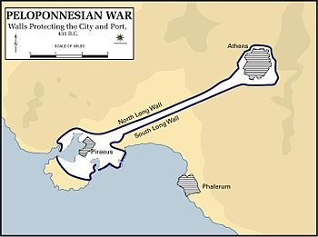
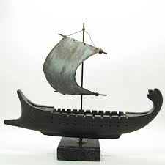
The War
Athens naval, Sparta a land force
Sparta landlocked
Athens hid behind there walls
Hit by a terrible plague
Attacks those they can
VS

Slide 13
Melian Dialogue
Athens sails to the Spartan colony of the Island of Melos
Tell them to surrender
Say they want to be neutral
Athens says “The strong do what they can and the weak suffer what they must.“ and kill everyone
Realism: In politics Power, not principle matters
Might makes right

Slide 14
End of the War
Athens invades Sicily and lose BADLY
Sparta allies with Persia
gets navy
destroys Athens navy
Sparta wins

Slide 15
Both Sides weakened
This leaves a power vacuum!

