Slide 1
Julius - End of the Republic

Slide 2
Lands prior to Caesar’s rise

Slide 3
Why did Rome keep spreading?

Slide 4
Recruiting Practices
Conquered New Lands
Gave Lands to retired soldiers
Recruited soldiers promising lands

Slide 5
Loyalty
Loyal to their commanders
Allowed guys like Julius to march on Rome, which started long before him.
Who is Julius?

Slide 6
Julius Caesar
Patrician
Served in Army and Senate
Ran for Consul
Formed an alliance to rule Rome

Slide 7
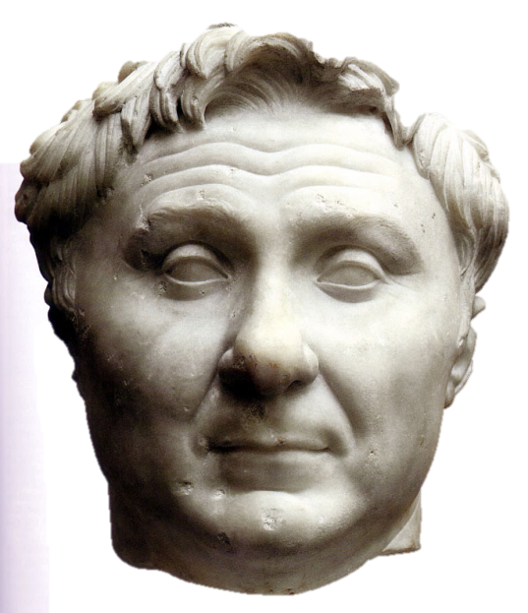
First Triumvirate
Julius Caesar
Crassus
Pompey the Great
Skilled Politician
Richest Man in Rome
Military Might

Slide 8
Governor of Gaul

Slide 9
Why Gaul?
Caesar was in debt
Want to invade Gaul to extort or pillage wealth
He raised four legions from Southern Gaul
Gaul was divided and made for an easy target

Slide 10
Process of Conquest
Slowly conquered Gallic lands
Crossed the Rhine to punish Germanic tribes
Crossed into Britain with minor success

Slide 11
End of the Triumvirate
Caesar’s daughter (Pompey’s wife) died in child birth
Crassus died battle the Parthians
Pompey broke alliance with Caesar
The following year, major revolt under Vercingetorix broke out in Gaul

Slide 12
Battle of Gergovia
Caesar gathering forces
Vercingetorix strikes
Caesar decided to meet in open battle rather than lose faith with allies

Slide 13
Battle of Gergovia
Romans
25,000 Romans
10,000 allied calvary
30,000 gauls

Slide 14
Battle of Gergovia
Vercingetorix mirrored Caesars move along the River Elave, destroying bridges
Caesar then camped, and ordered 1/3 of his force south
The Gauls followed this group and Caesar rebuilt a bridge and crossed
They reached Gergovia five days later

Slide 15
Battle of Gergovia
Caesar took a vital supply point in a night raid and then fortified it
Vercingetorix convinced a Caesar allied tribe to flip sides and was able to take Caesars supplies
Caesar conquered these tribes and returned

Slide 16
Battle of Gergovia
Caesar ordered a retreat to lure the Gauls out of the fortified position
Many did not hear the call and assaulted the town instead
The incoming Gaul allies Caesar brought were mistaken as enemies and his legions attack them
Vercingetorix charged to take advantage of the chaos
Caesar retreated

Slide 17
Interlude
Vercingetorix added other tribes to his army
Pursued guerilla warfare and attacked supply lines
He then retreated to Alesia for the winter.
Caesar pursued and laid siege to the city

Slide 19
https://www.youtube.com/watch?v=Ut9GdMywFj0

Slide 20
Caesar’s Civil Wars

Slide 21
Caesar’s Political Situation
The triumvirate ended with the death of Crassus and Caesar’s daughter Julia
Pompey named as sole consul
Caesar was becoming a military hero and champion of the people

Slide 22
Caesar’s Dilemma
Fearful of Caesar, the senate ordered him to disband his army
Caesar said he would, if Pompey did as well
Senate threatened to declare a traitor
Previously tried to charge him with corruption (and war crimes) but vetoed by Mark Antony
Caesar could
A)Enter Rome without and Army and be arrested
B)Keep his army

Slide 23
What is Caesar to do?

Slide 24
Cross the Rubicon
Caesar crosses the Rubicon river and says “The Die is Cast” an act of war
He has with him one legion

Slide 25
Italy Proper
Pompey retreated from Rome, showing weakness
Caesar trapped Pompey’s allied army, who joined him (4 legions now)
Pompey ferried his forces to Greece

Slide 26
Ilerda Campaign
Caesar conducted a quick march to attack Pompey’s armies in Hispania
JC had 37,000 men Pompey had 67,000
A series of skirmishes, small sieges, and pursuit
All 7 legions surrendered to Caesar

Slide 27
Pompey’s decision
JC was now pursuing him into Greece
Had 3 options
Allie with Parthia
Invade Italy
Fight Caesar
Decided to Fight JC
Met at the Battle of Dyrrhachium

Slide 28
Battle of Dyrrhachium
Caesar sailed his troops to Greece despite Pompey’s naval supremacy
Some of his army was stranded
Marc Antony was later able to land 4 more legions
JC and Pompey raced to the new army
Pompey realized who could get stuck fighting on both sides went to Dyrrhachium

Slide 29
Battle of Dyrrhachium
JC laid siege and started building walls
Pompey began running out of supplies and decided to break out
Found the weak point and Caesars wall and conducted a multi-front assault

Slide 30
Battle of Dyrrhachium
Caesar counter attacked multiple times without success
Eventually Caesar’s troops routed and fled
Pompey did not pursue, fearing a trap

Slide 31
Caesar moves South
Moved into Thessaly
JC and Pompey both had armies there
JC’s men had time to resupply, and rest
prominent men in Pompey's camp argued for battle
Pompey did what they wished and met at Pharsalus

Slide 32
Battle of Pharsalus
Caesar
Pompey
22,000 Legionaries
8,000 Allies
1,800 Calvary
40,000 Legionaries
4,200 Allies
6,500 Calvary

Slide 33
Initial Deployment
Pompey
3 lines, ten deep
Massed Calvary on the left
Wanted to wait Caesars charge, use calvary as hammer and anvil
Caesar
3 lines, 6 deep
Calvary and a fourth line on the right to counter Pompey’s superior Calvary
Ordered Third line not to charge until ordered

Slide 34
Initial deployment

Slide 35
Battle
The front two lines of Caesars Army engaged Pompey’s infantry
Pompey’s Cavalry attacked JC’s cavalry but hidden 4th line emerged, and stabbed Cavalry with javelins and routes Pompey’s calvary
Caesar ordered his third line to attack, breaking Pompey’s now exposed left wing
Pompey flees to Egypt, his army destroyed
Caesar lose 230, Pompey 15,000

Slide 36
https://www.youtube.com/watch?v=QWeeq7dyktA

Slide 37
Pompey’s Motivation for Egypt

Slide 38
Pompey’s Motivation
Pompey was trying to get money and men to continue the fight
Caesar was relentless and he was not able to gather a force
Eventually went to Egypt, as Pharaoh Ptolemy XIII’s father owed Pompey
Pharaoh Ptolemy was at war with his sister Cleopatra

Slide 39
Pharaoh Ptolemy XIII’s choice
If he excepted Pompey, he becomes a master and Caesar an enemy
If he sends him away, Pompey and Caesar both blame Egypt
If he kills Pompey, friend of Caesar and Pompey not a threat

Slide 40
The Choice is wrong
Caesar is furious that they killed Pompey
He wants to pardon Pompey, to show benevolence
In addition, he is “charmed” by Cleopatra and overthrows the Pharaoh
They have a son

Slide 41
Cleopatra
Caesar chased Pompey to Egypt
Murdered by Pharaoh Ptolemy, who was at war with his sister
Caesar sided with Cleopatra

Slide 42
The Real Cleopatra

Slide 43
North Africa
Pompey’s forces completely destroyed Caesar’s army in North Africa
Cato the Younger takes additional troops their to continue the fight
Caesar needs more Troops

Slide 44
Mutinous Legions

Slide 45
War on Cato-Battle of Ruspina
Caesar outnumbered 2-1
Numidian Calvary effectively damaging Caesar
Caesar breaks out and both sides return to camps
Caesar loses 1/3 of his army

Slide 46
Battle of Thapsus
JC
Cato’s Allies
50,000 Infantry
5,000 Cavalry
72,000
14,500 cavalry
Numidian troops
60 elephants

Slide 47
Resistance continued in Spain
Caesar’s former friend and Pompey’s son fled to Spain to continue fighting
Caesar pursued and the remaining Optimates refused battle
After successful skirmished and siege tribes began betraying them and many planned to defect to Caesar
Force open battle

Slide 48
Battle of Munda
Caesar
Optimates
40,000 men
70,000 men

Slide 49
Battle of Thapsus
Caesar commanded Cavalry on the left, aided with infantry against elephants
Elephants targeted with archers and many charged their own ranks
Those who didn’t where destroyed by Caesar's center
Julius’s cavalry outflanked Cato’s troops who began to flee
Cato committed Suicide:
“Cato, I must grudge you your death, as you grudged me the honour of saving your life.”

Slide 50
A bloody Battle
Many of the troops had fought in previous campaigns
Feared Caesar would not pardon them a second time.

Slide 51
Battle of Munda
Caesar charged enemy lines
Battle lasted 8 hours, Caesar Joined the fight (fighting for his life.
Inspired, right wing begins to break thru
Pompeius weakens his right to reinforce against a breakthru
Cavalry charged the now weakened left
Pompeians retreated, many slaughtered, 30,000 died to 7,000 of JC’s men

Slide 52
JC Master of Rome
Named Dictator for Life
Gave land to his legions
Reformed the debt of many Romans
Rewarded families for having many children
Rebuilt Carthage and Corinth
Created a new Calendar
Mobilized Huge army to attack Parthia and Dacians

Slide 53
Stabbed 23 times
Senators claimed to be saving the Republic
Miscalculated the peoples love Caesar
Would eventually lead to the end of the of the Republic

Slide 54
Saving the Republic
Roman Republic
(509 BCE – 27 BCE)
Roman Empire
(27 BCE - ??????)
Roman Republic
(509 BCE – 27 BCE)
Roman Empire
(201 BCE - ????)
Notes:
Roman Empire
(264 BCE - ????)

Slide 55
Liberators' civil war
General, Mark Antony and Caesar’s heir Octavian begin the Liberators Civil War

Slide 56
Failure of Second Triumvatate

Slide 57
Justice and Civil War
Shortly after, Octavian and Antony fought
Cleopatra side with Antony
Octavian defeated them both

