Slide 1
The Ottomans

Slide 2
Background
Constantinople was the fortress capital of the Byzantine Empire and one of the richest cities in the world.
Muslims had been trying to conquer it for nearly 800 years
Others before them
Why was Constantinople so rich?
Why was Constantinople so difficult to conquer?

Slide 3
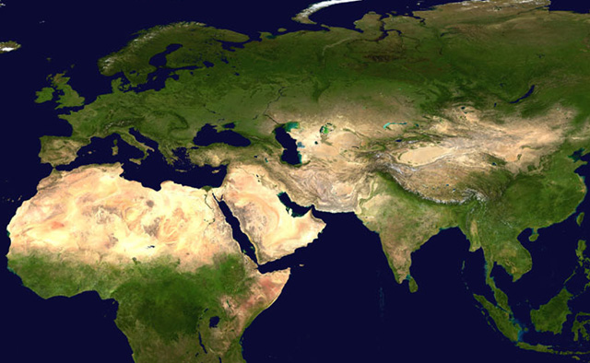
Where was Constantinople?
(Istanbul today)
Notes:
This is a broad view of Afroeurasia. Where was Constantinople in this picture?

Slide 4
Why might this location have been important?
Notes:
Here is the answer. Have students make some observations about location.

Slide 5
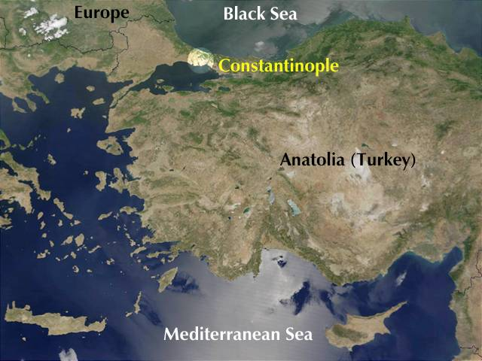
Notes:
It also lies between the Black Sea and the Mediterranean Sea, which were major highways of trade and travel.

Slide 6
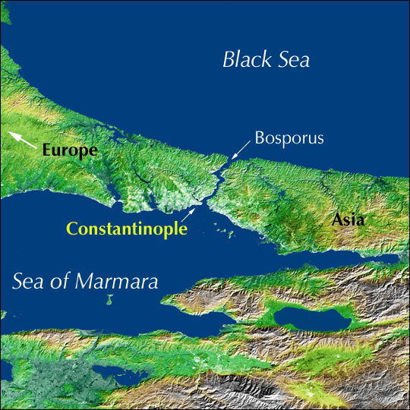
Notes:
The narrow Bosporus strait is the only path that connects the Black Sea with the Aegean and Mediterranean seas. Constantinople’s location at the southern end of the strait gave it command of trade between these seas.

Slide 7
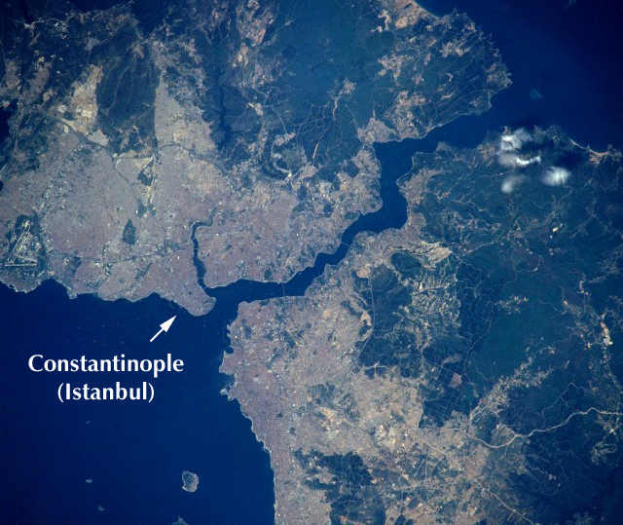
Why would this city be difficult to conquer?
Notes:
Have students speculate about why this location would be easy to defend.
Notice that the city was located on a peninsula, and was thus surrounded on three sides by a sort of natural moat. The forth side was defended by a formidable series of immense fortifications.

Slide 8
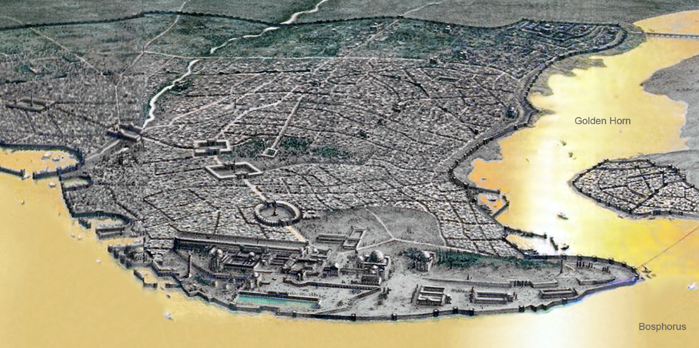

Slide 9
Ottomans
A small group of Turks, led by Osman, settled near Constantinople
after being defeated by the Mongols
Ottomans began spreading, and completely surrounded Constantinople
Temporarily saved by Tamerlane
Sultan Mehmed II came back to finish the job

Slide 10
Why Constantinople?
One of greatest cities in history
A great deep-water port
Strong and Wealthy city, built to impress
Byzantines were declining rapidly
Especially after the 4th Crusade
Unwise to let a nation survive inside your empire.

Slide 11
Defenses
The city had about 12 miles of walls
one of the strongest sets of fortified walls in the world
A defensive chain be placed at the mouth of the harbor.
Prevent ships from entering
Gave hope of survival until help came…but it didn’t

Slide 12
Olive Branch
After days of fighting, Mehmed offered to lift the siege
would allow all inhabitant to leave with their stuff
would recognize the Emperor as governor of the Peloponnese.
guaranteed the safety of the remaining population
The Byzantine Emperor said no

Slide 13
Results
Ottoman casualties unknown thought to be very heavy
blood was described flowing in the city "like rainwater in the gutters after a sudden storm“
Mehmed II promised three days plunder
30,000 civilians were enslaved or deported
Many others killed
Destruction so thorough that Mehmed II is said to have cried “What a city we have given over to plunder and destruction”

Slide 14
It’s Istanbul
Mehmet II called the Fatih (the Conqueror)
Constantinople, renamed Istanbul
Mehmet II rebuilt the city and built many public works
Bribed people to move to Istanbul

