Slide 1
“New Imperialism”

Slide 2
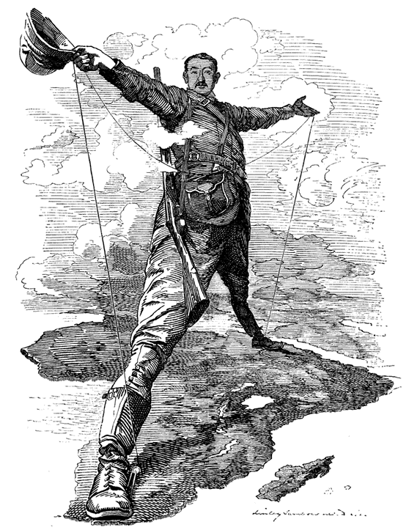
What is it
Old Empires disappeared with Atlantic Revolution
New era of conquest
88% of world dominated by “Western” powers

Slide 3
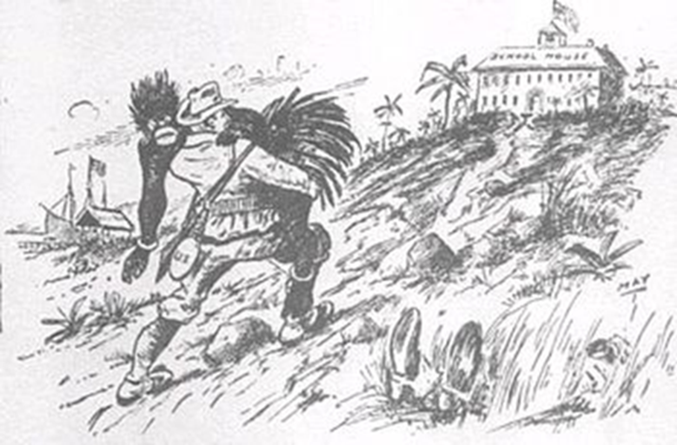
Motives
Industrial Capitalism
Markets for Goods
Access to Raw Materials
Advanced Medicine
Malaria
Advanced Weapons
Maxim Gun
Social Darwinism / Racism / White mans Burden
Distract the Poor

Slide 4
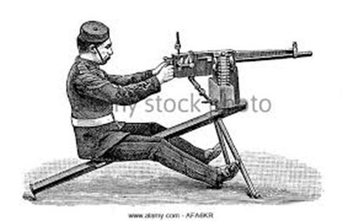
How is this Possible?
Centralized States
Industrial Economies
Advanced Medicine
Invade Tropical Areas
Advanced Weapons
Maxim Gun
Social Darwinism / Racism
Notes:
“Whatever happens, we have got The Maxim Gun, and they have not.”
The impact of the Maxim gun was experienced most viscerally in 1898, when a British and
Egyptian force moving up the Nile seized a large portion of Sudan from the far larger Muslim
army of the state called Mahdiyya. In the crucial battle at Omdurman, British forces lost 40 men.
The Mahdiyya army lost 11,000.

Slide 5
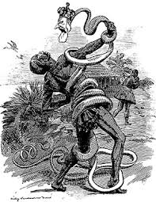
Results
Western Dominance
Disruption of culture and economies
Seeds of:
Modern World Economy
Middle Class
Uneven Wealth

Slide 6
Winners and Losers
Winners
Losers
Europeans
Americans
Japanese
Elites in cononies
Most everyone else
Notes:
convinced the world powers to grant him administrative rights over a “Congo
Free State” for the express purpose of ending slavery and bringing modern civilization to
primitive people. Immune to his own hypocrisy, Leopold proceeded to turn an area the size of
western Europe into his personal slave plantation for the hunting of ivory and, later, rubber.

