Slide 1
Origins of Mongol Explosion

Slide 2
Mongol Society
Pastoral Nomads
Necessitated marshal prowess
Dependent on Trade/Raid for some goods
Society divided into clans
Infighting/Wife stealing

Slide 3
Rise of Chingiz Khan (Gengis)
Son of a chieftain
Small tribe
Gained power
Leadership
military prowess
Had setbacks
Some defeats
Repeatedly deserted

Slide 4
Rise of Chingiz Khan (Gengis)
Changed Social Structure
Loyal to him rather than tribe and family
Required constant success
Promoted based on skill and loyalty

Slide 5
Chingiz Khan and the Yasa
Supreme law code
Covered many aspects
Murder
Other Mongol, death
Nonmongol, fine
Equal share of bounty
Beautiful women went to the Khan first

Slide 6
Mongol Logistics
Originally lived of the land
Later used tribute states to supply
Took in depth records
Officials from other parts of the empire
Would buy supplies near planned invasions

Slide 7
Mongol Soldier
Typical Steppe Soldier
Started riding horses at 3 years
Eventually learning how to sleep while riding
Received a bow at 5 year
Spent most days practicing these until 16 years

Slide 8
Weapons
Compound Bow
200-300 yard range
Multiple types of arrows
4 ponies each
Lance with a hook
Short Sword
Mostly leather armor

Slide 9
Strategy and Tactics
Ambushes
Feigned Retreats
Approached targets in dispersed columns
Experts of envelopment

Slide 10
Other Strategies
Human Shields
“Smoke Screens”
Imported Siege Weapons
Terror

Slide 11
About Chinggis
How did a southern Chinese Author describe Genghis?
How did Indian historian Juzjani describe Genghis?
How did he describe himself?
Describe Genghis based on the collection of sayings from Rashid al-Din
What did Genghis's laws say about him?
Of these Characteristics, which would help most in conquest?
Turning the Mongols into a war machine
Why did the Mongols fight each other?
Besides other tribes, who was often a Mongol target?
What specialists existed in their society?
Describe women in Mongol society
How were women and children used in battle?
What was a major flaw in the Mongol system?
How did he pick officials?

Slide 12
Mongol Empire
The Campaigns of Conquest

Slide 13
Invasion of Xi Xia
Culturally Chinese state
Mongols not good at siege warfare
Devastated the countryside, became a subordinate state
Protected Mongolian flank

Slide 14
Invasion of Jin China
Originally focused on tribute, launched in 1211
Jin rulers formally nomads (Jurchen) and did not fall for Mongol tactics
Better mobility allowed victory
Devastated farmland, many died from starvation

Slide 15
Invasion of Jin China
Focus changed to occupation in 1215
Defected/captured China soldiers and Siege units helped
Many Jin troops protecting the South
Beijing destroyed, said to burn for a month

Slide 16
Invasion of Khwarazmian Empire
Iranian/Central Asian Empire
Chingiz wanted trade relations with them
1218, Shah Ala al-Din Muhammad had most envoys executed, others shaved

Slide 17
Invasion of Khwarazmian Empire
1219, Chingiz Khan gather 100,000 men
Invaded in three columns
Muhammad’s forces superior in number but disloyal and scattered
The Caliph of Bagdad refused to help

Slide 18
Invasion of Khwarazmian Empire
Those who surrendered were spared
Cities that resisted were completely destroyed
After taking the capital Samarkand, each Mongol was assigned a number of civilians to murder

Slide 19
Invasion of Khwarazmian Empire
The Western region was considerably more difficult
Most the soldiers were steppe nomads
Use of terror was more pronounced
Destroyed irrigation, many starved
Notes:
One of these groups moved to Anatolia and founded the Ottoman Empire

Slide 20
Invasion of Russia
Originally an explorative expedition
Ravaged the countryside gaging resistance
A Russian/nomad coalition formed but was crushed
Mongols return home

Slide 21
Invasion of Russia
The Mongols returned 12 years later
Resistance was sparse due to disunity
Mongols attacked cities one as a time
Built walls around them and burnt them down
The stench of thousands of burning bodies overwhelmed even the Mongols
Notes:
Main target was the once prominent Kiev
It fell, and others
Only 2,000 of 50,000 citizens survived

Slide 22
Invasion of Poland
Carefully planned conquest
Spies spread rumors of Mongol terror
Mongols outnumbered 2-1
Poland is politically divided
Polish forces attack,
fell for feigned retreat
Mongols filled the field with smoke
Polish forces crushed

Slide 23
Invasion of Hungary
Mongol invasion of Hungary
Battle of Mohi
Mongols outnumbered 2-1
Mongols feigned retreat for multiple days
Used catapults and smoke pots to confuse the Hungarians
The slaughter lasted multiple days

Slide 24
Invasion of Western Europe
Kingdoms prepared for Mongol invasion
The Pope called for a crusade
Ogodei Khan died and Batu Khan had to return Karakorum
Forces returned to Russia and Europe spared

Slide 25
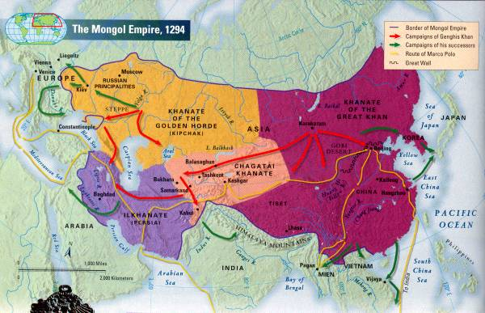

Slide 26
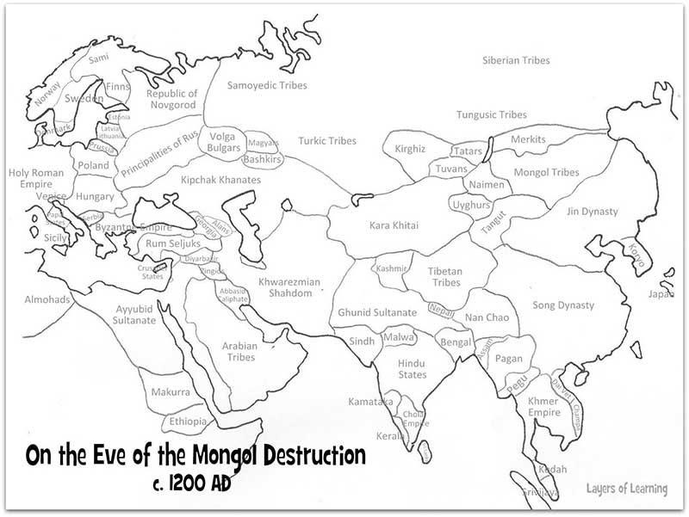

Slide 27
Conquest after Chingiz
Invasion of Europe and Persia a sign of Chingiz’s success
1251, Kublai sent to conquer Song China
Hulegu sent to the Muslim world to:
conquer the Assassins
conquer independent lords
The Caliph of Bagdad to submit
Defeat the Mamluks and incorporate Syria and Egyt

Slide 28
Invasion of Persia
Most surrendered to Hulegu
This included the leader of the Assassins, saving many years of siege warfare
Proceeded to Bagdad

Slide 29
Invasion of Persia
Hulegu asked the Caliph to submit
The letter was insulting, the Caliph told the Mongols to submit
Hulegu surrounded Bagdad
Bagdad resisted but eventually surrendered

Slide 30
Invasion of Persia
Citizens ordered to leave, those who refused slaughters
Bagdad burned, 90,000 massacred
The Caliph rolled in a rug and trampled by horses
The destruction to the Islamic world was incalculable

Slide 31
Battle of Ayn Jalut
Pushing towards Syria and Egypt
Great Khan Möngke died
Hulagu returned, leaving a small force behind
Mongols outnumbered, ambushed
Fought Bravely but Mongols finally defeated in the field

Slide 32
Collapse
Mongol Empire divided into four
Lasted for a while but eventually disolved

Slide 33
Other Campaigns
Korea
Song China
Japan
Java

Slide 34
Assignment
Summarize the main points for each sections
Write a short essay (one page) taking a side on whether the Mongols were a positive or negative force in history
INCLUDE SPECIFIC EVIDENCE FROM READING, UNDERLINE THE EVIDENCE

