Slide 1
The Qin and Han Eras

Slide 2
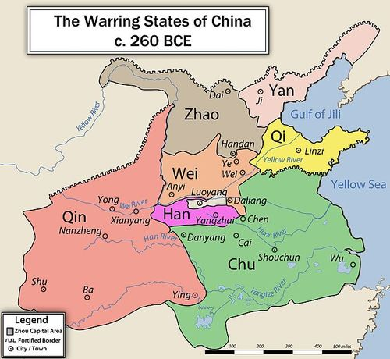
The Qin
Qin was the Western most province
Experience fighting Nomads
Protected by Mountains
Conquered great agricultural lands
Practiced Legalism
  Strong Central Rule
  Stressed use of Professionals

Slide 3
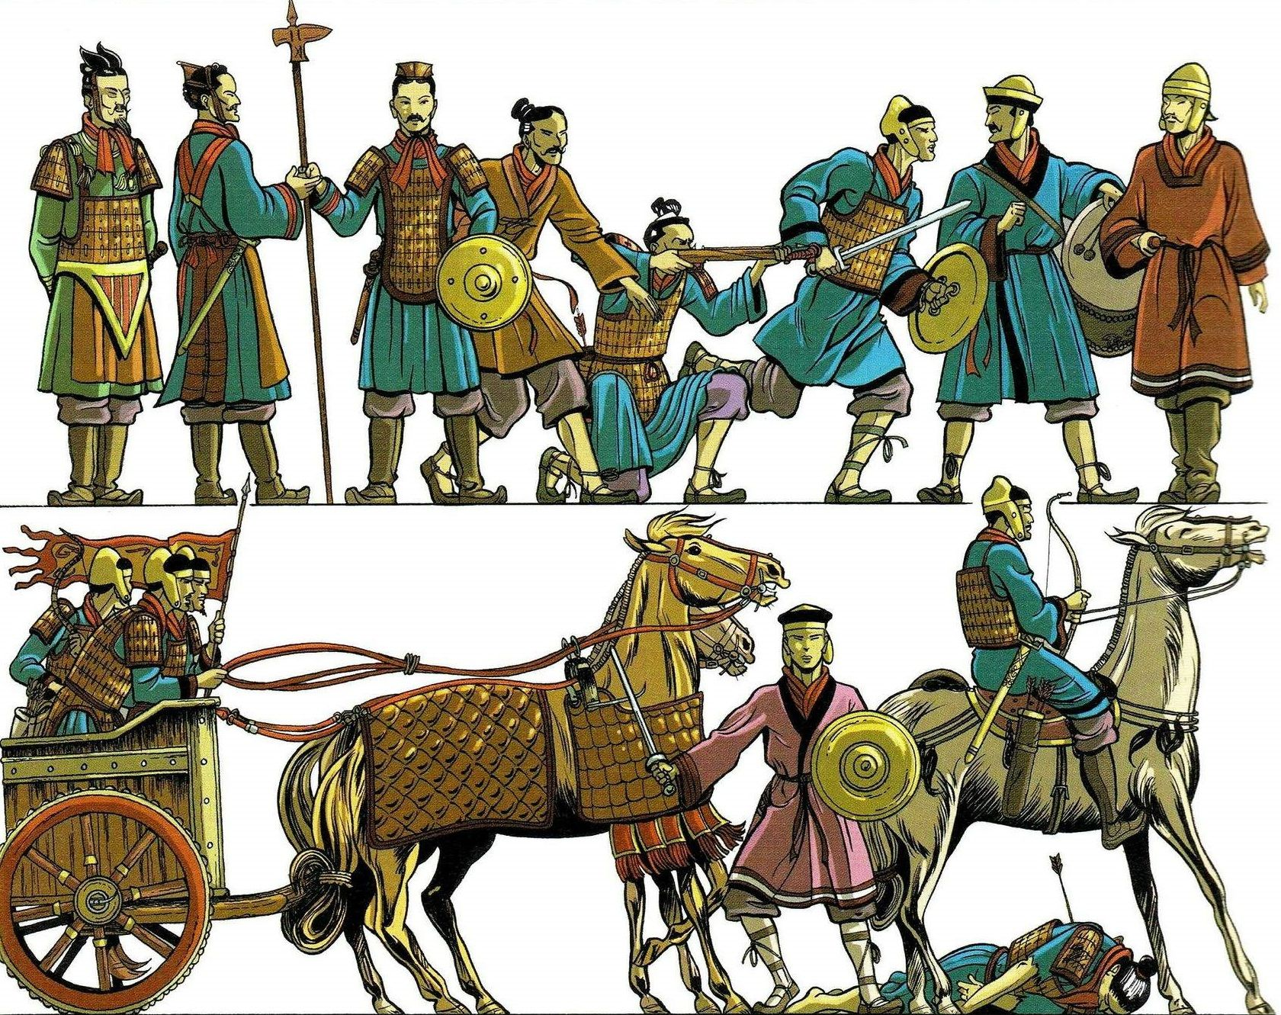
Qin Rule
Imposed central and systematic control
The role of the army critical
  Maintain peace
  Crush resistance
The army took a major role in civilian affairs – a military state

Slide 4
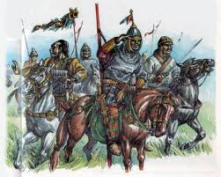
Expansion
After unification, the Qin set out to expand
  To the North against nomads
  To the South against tribal peoples
Qin also built a navy to transport armies down rivers

Slide 5
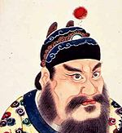
Collapse
The Qin lasted as long as its first emperor
Rule was strict
Taxes were extreme
Rebellions broke out, and a commoner claimed the throne

Slide 6
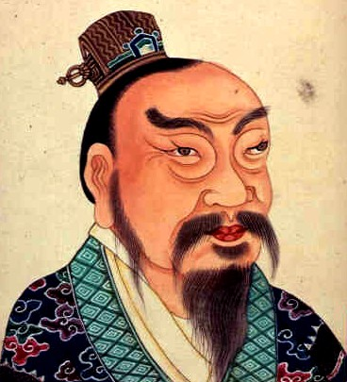
Han
Founded by Gaodi
  Won support by sparing enemies and limiting pillage
Military issues focused on reuniting China (Qina)
Outside threats existed, in particular Nomads
  Campaigns against them failed
  Resorted to paying them off
Gaodi slowly reunited China

Slide 7
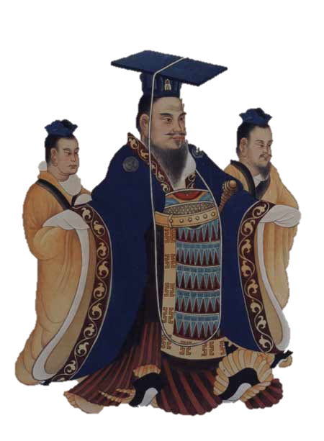
Campaigns of Han Wudi
The Han Empire had become wealthy
Faced increased raids from Nomads
There was strong desire to secure the Silk Road trade
Han wealth meant few could match their tech

Slide 8
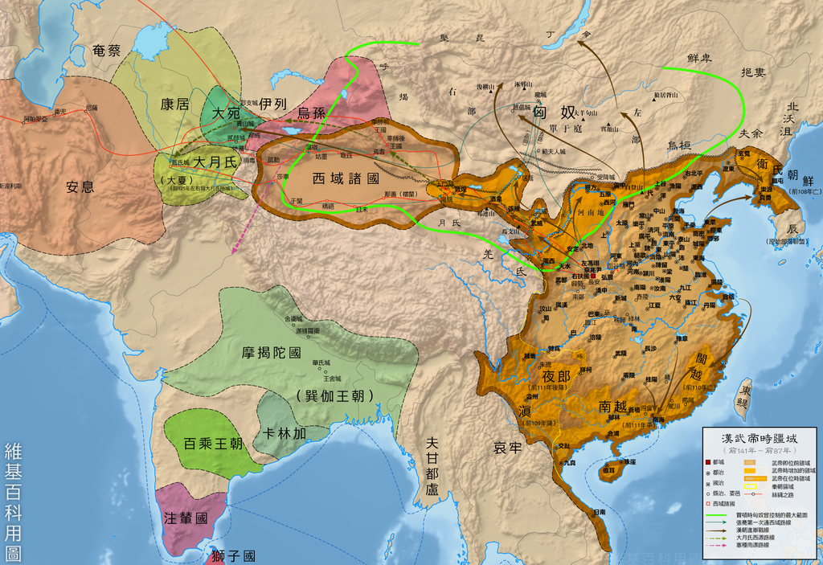
Continued
Wudi expanded in every direction
  Notably conquering Korea and driving deep into Nomadic lands
Armies were similar to those of warring states
  Massed crossbowman
  Flanks protected by spearman
  Incorporated allied nomad cavalry

Slide 9
Continued
Lands suitable for agriculture were colonized (often convicts)
Garrisons established on the silk road
Some major defeats occurred at the end of his rule, left China broke

Slide 10
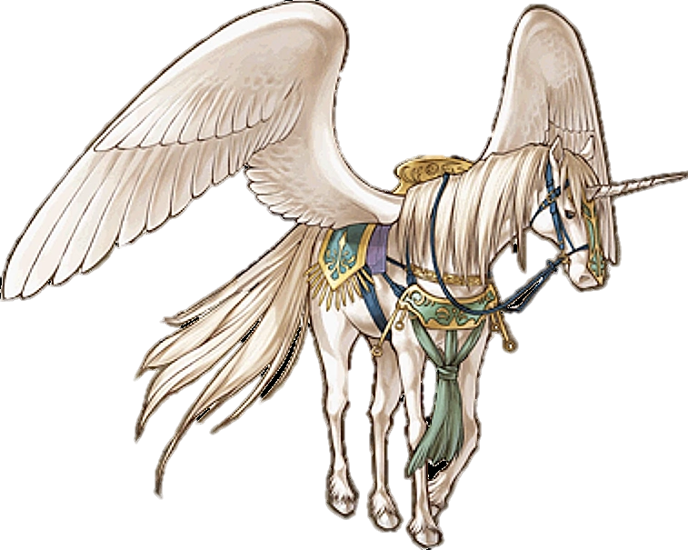
Later Han
Military colonies became a target of nomads
  Walled and protected by crossbowman
Horses became necessary to protect trade
  Occasionally attacked nomads to steal horses
  “War of Heavenly Horses”

Slide 11
Fall of the Han
Raids became increasing devastating
Trade routes were lost
Regional families ruled independently
Rebellions became common
China became divided once again

